Slide 1

Object Detection with Customized Data(NIA) using YOLOv3-edge
TESTWORKS
AI개발팀 강 응 찬
yeschan@testworks.co.kr
Copyright ⓒ TESTWORKS Artificial Intelligence Lab. All rights reserved.

Slide 2
TESTWORKS
List of contents
train data(4만), valid data(2천)
bbox(xml) → YOLO
YOLO dataset
training

Slide 3
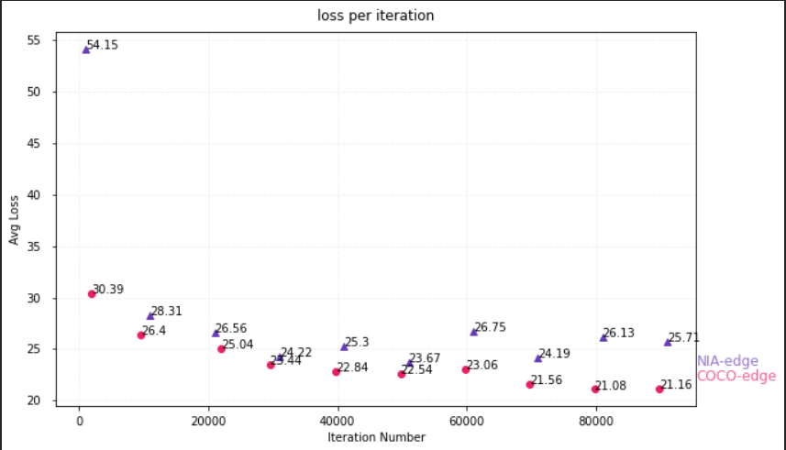
TESTWORKS
Average loss log data

Slide 4

TESTWORKS
Dataset Build Process
class : 27
batch : 64
max_batches : 100200
filters : 96
GIMP
Images
(train, valid)
labels
(train, valid)
Image set
bbox(.xml)
Hard coding
(VOC, COCO, KITTI)
YOLO dataset
nia.names
train.txt
valid.txt
nia.data

Slide 5

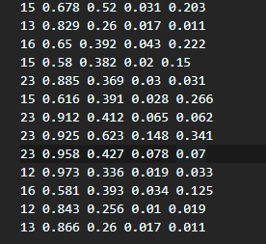
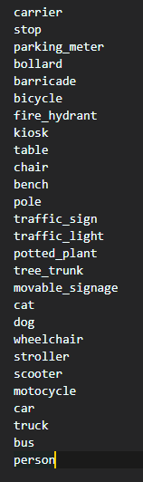

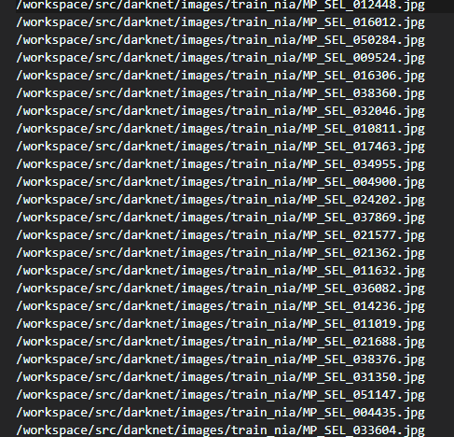

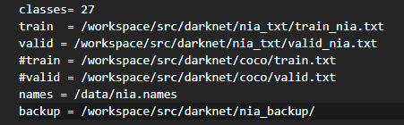
TESTWORKS
Dataset structure
Dataset instances
labels
images
.names
train.txt
train
valid
labels
train
valid
train
valid
.data
data
names.list
.names
.data

Slide 6
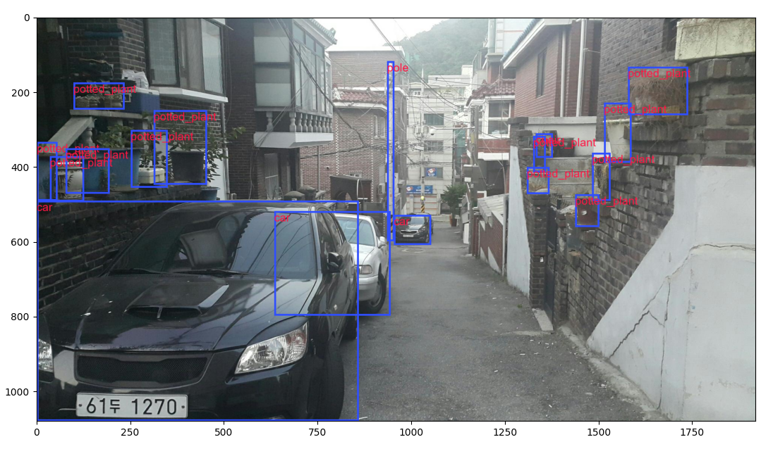
TESTWORKS
Testing after build YOLO dataset

Slide 7
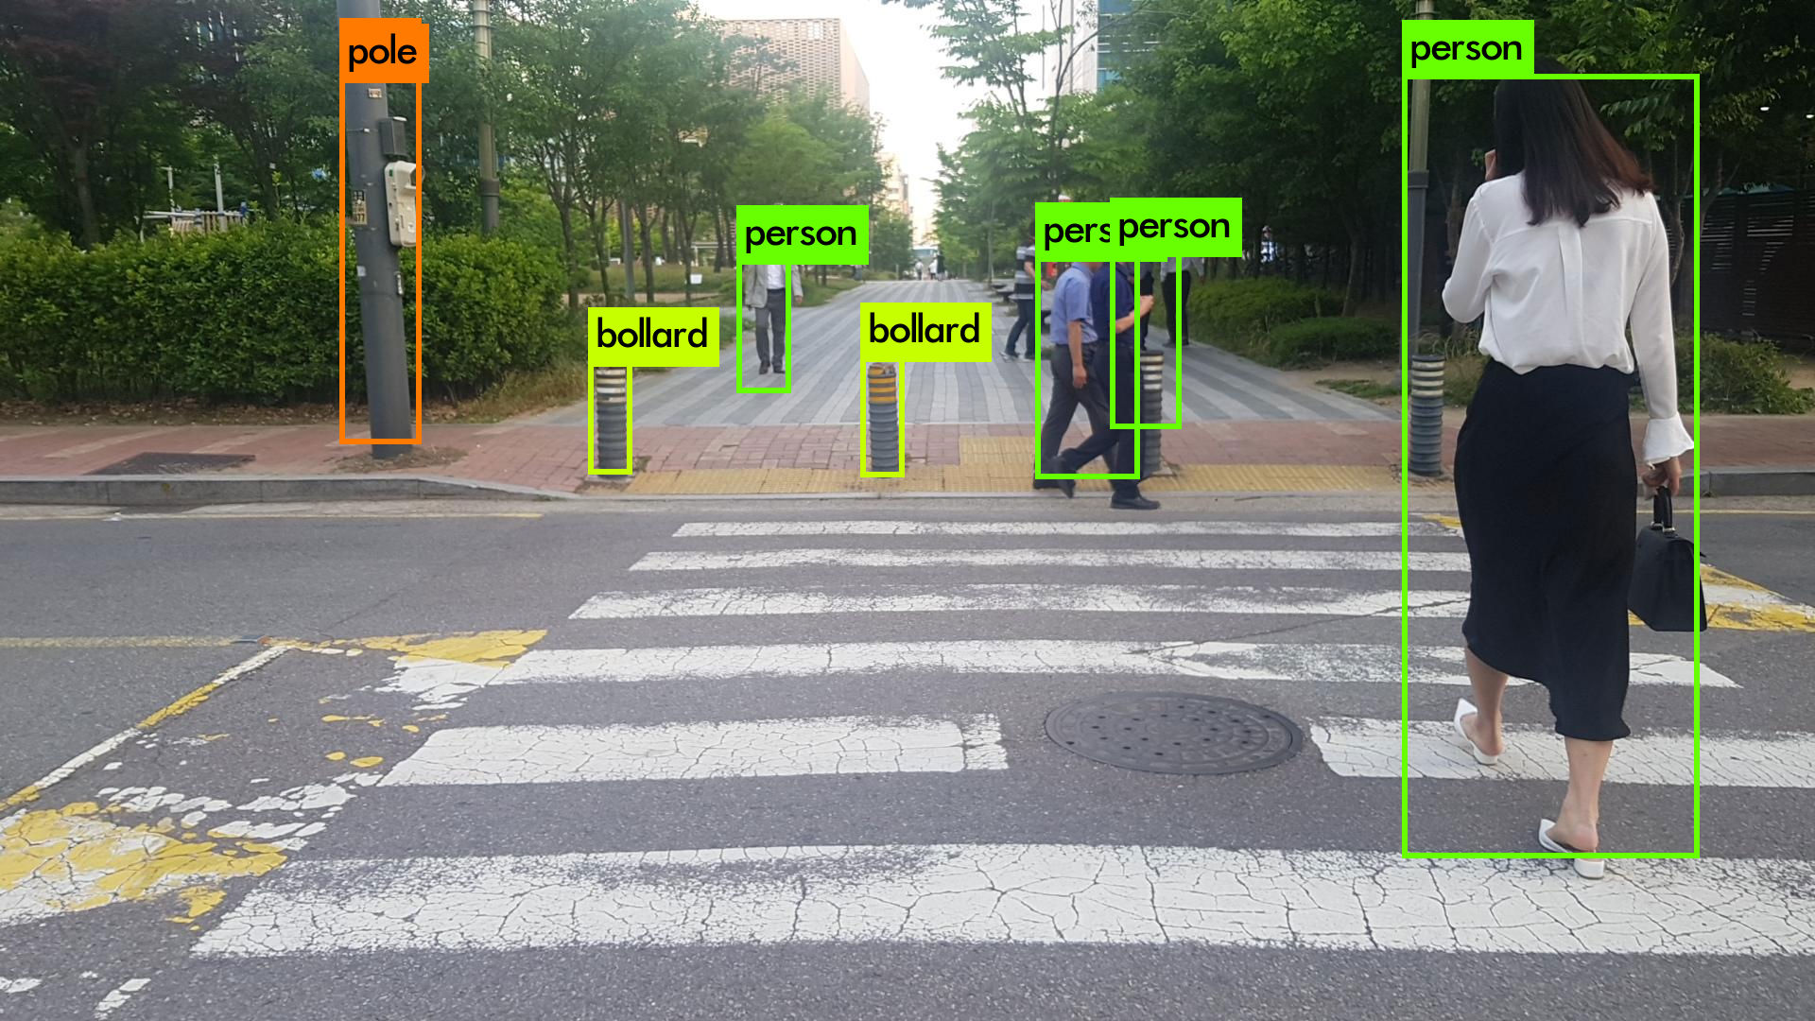
TESTWORKS
Result of training with NIA dataset

Slide 8
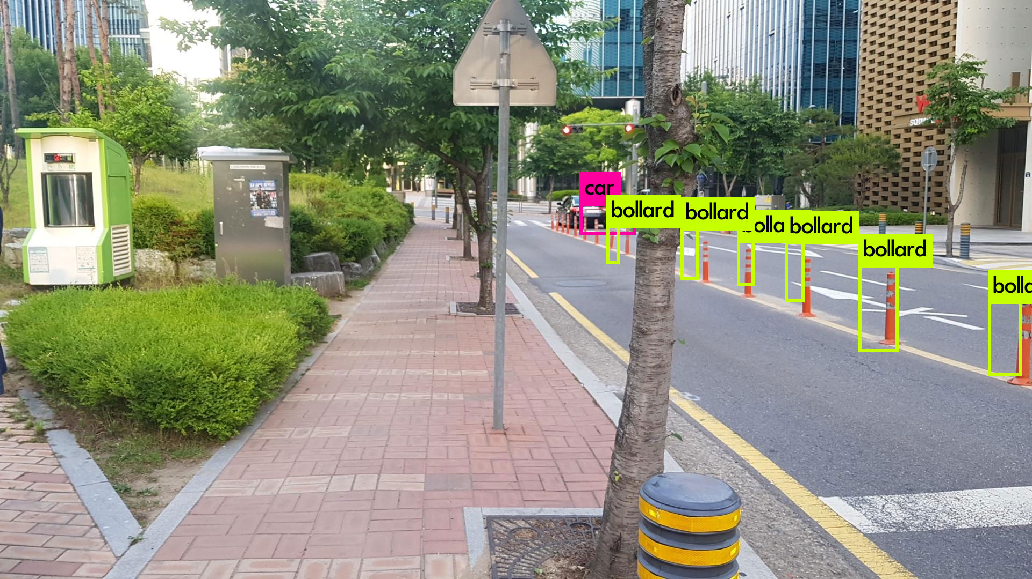
TESTWORKS
Result of training with NIA dataset

Slide 9
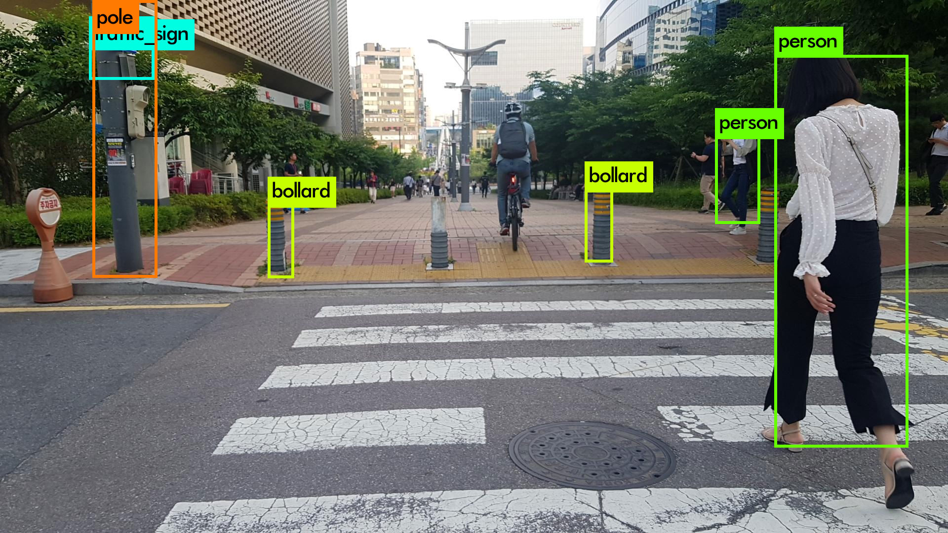
TESTWORKS
Result of training with NIA dataset

Slide 10
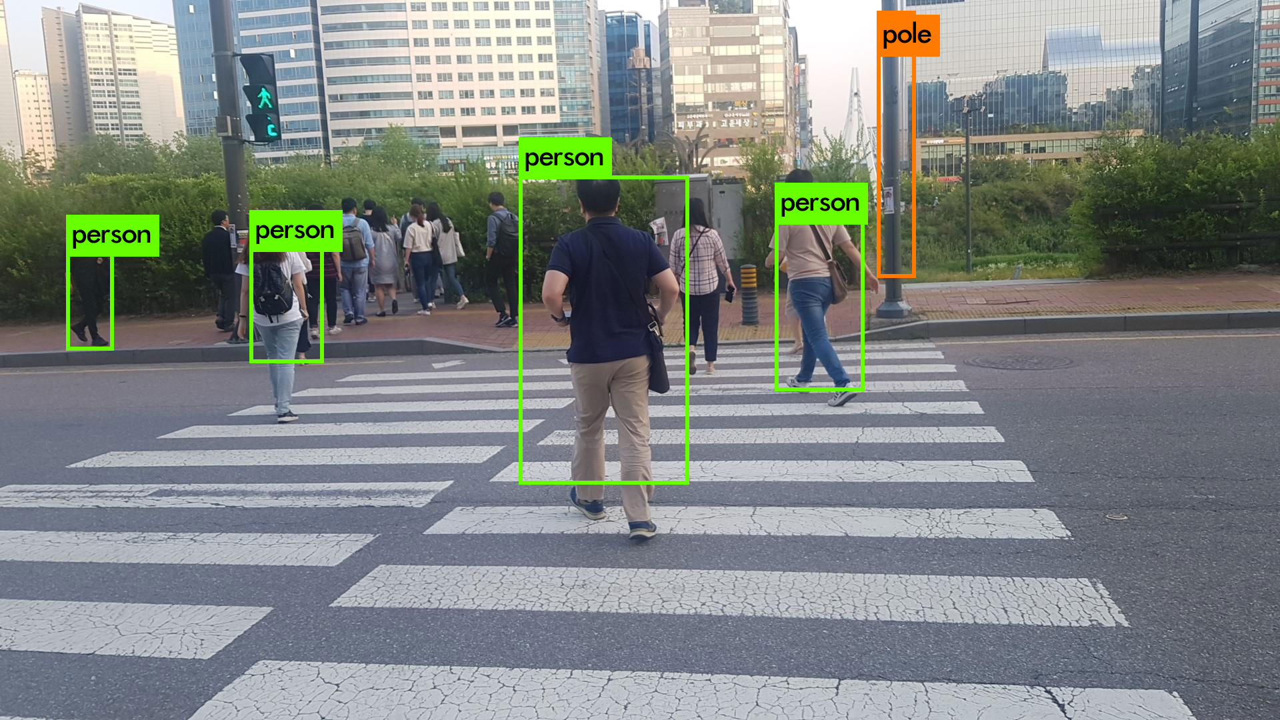
TESTWORKS
Result of training with NIA dataset

Slide 11
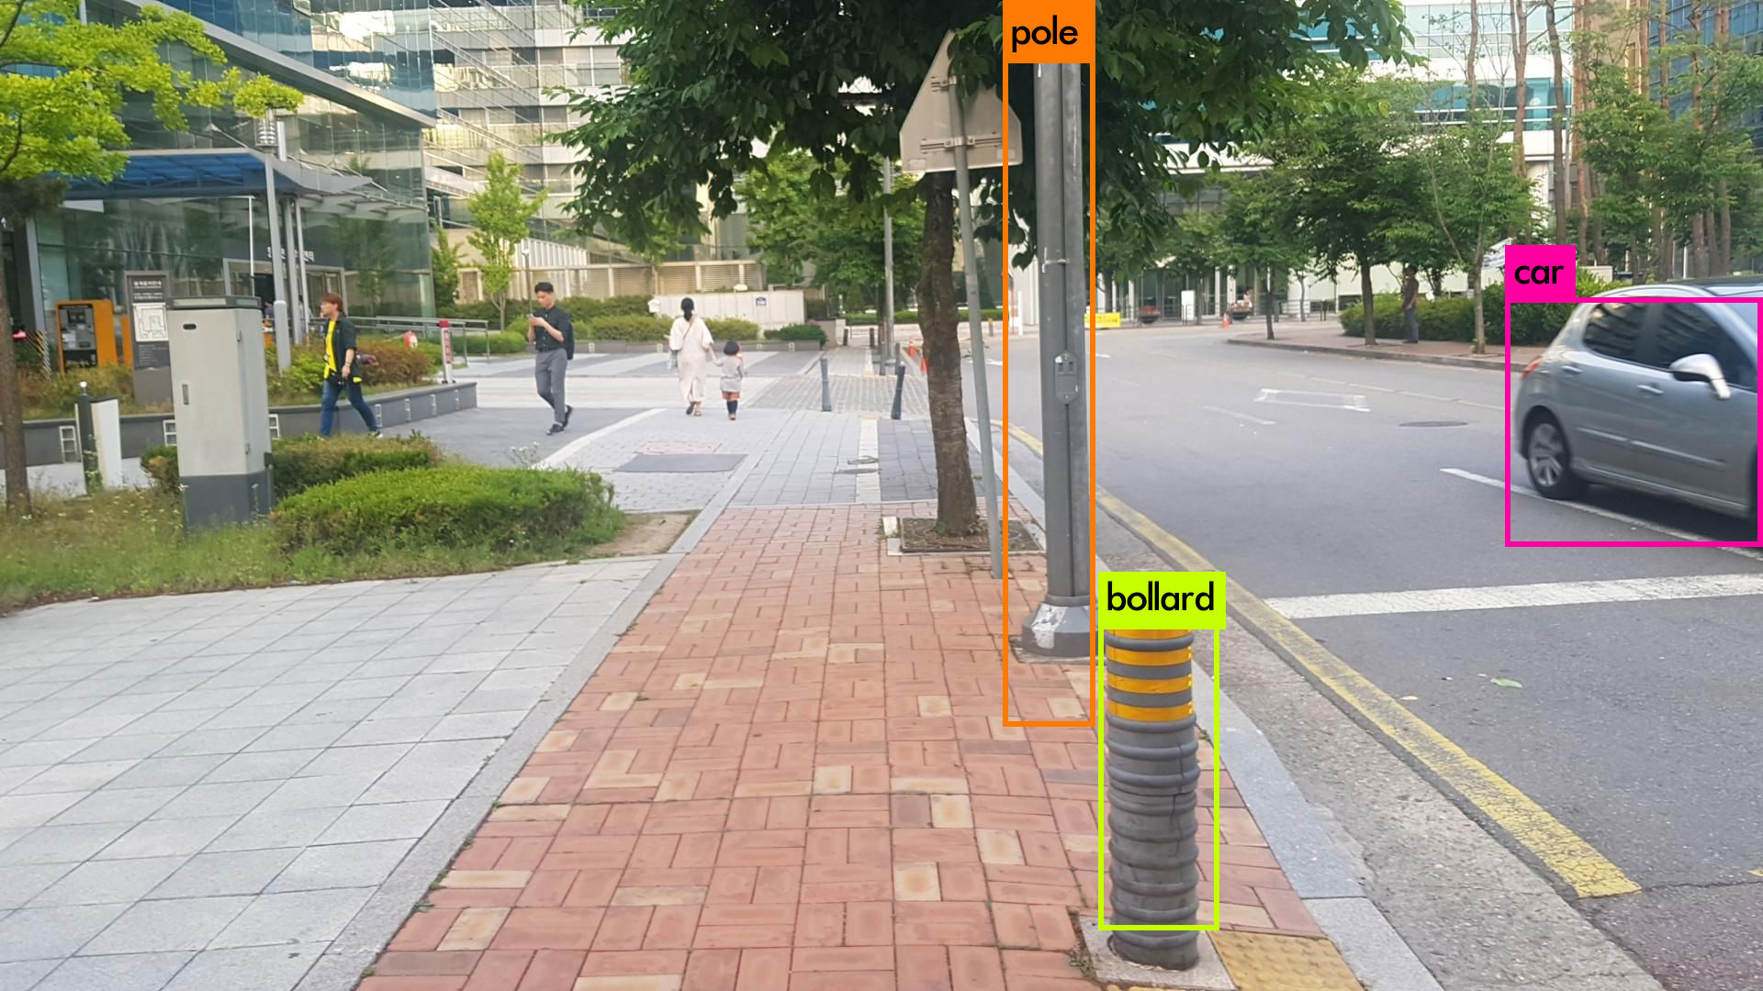
TESTWORKS
Result of training with NIA dataset

Slide 12
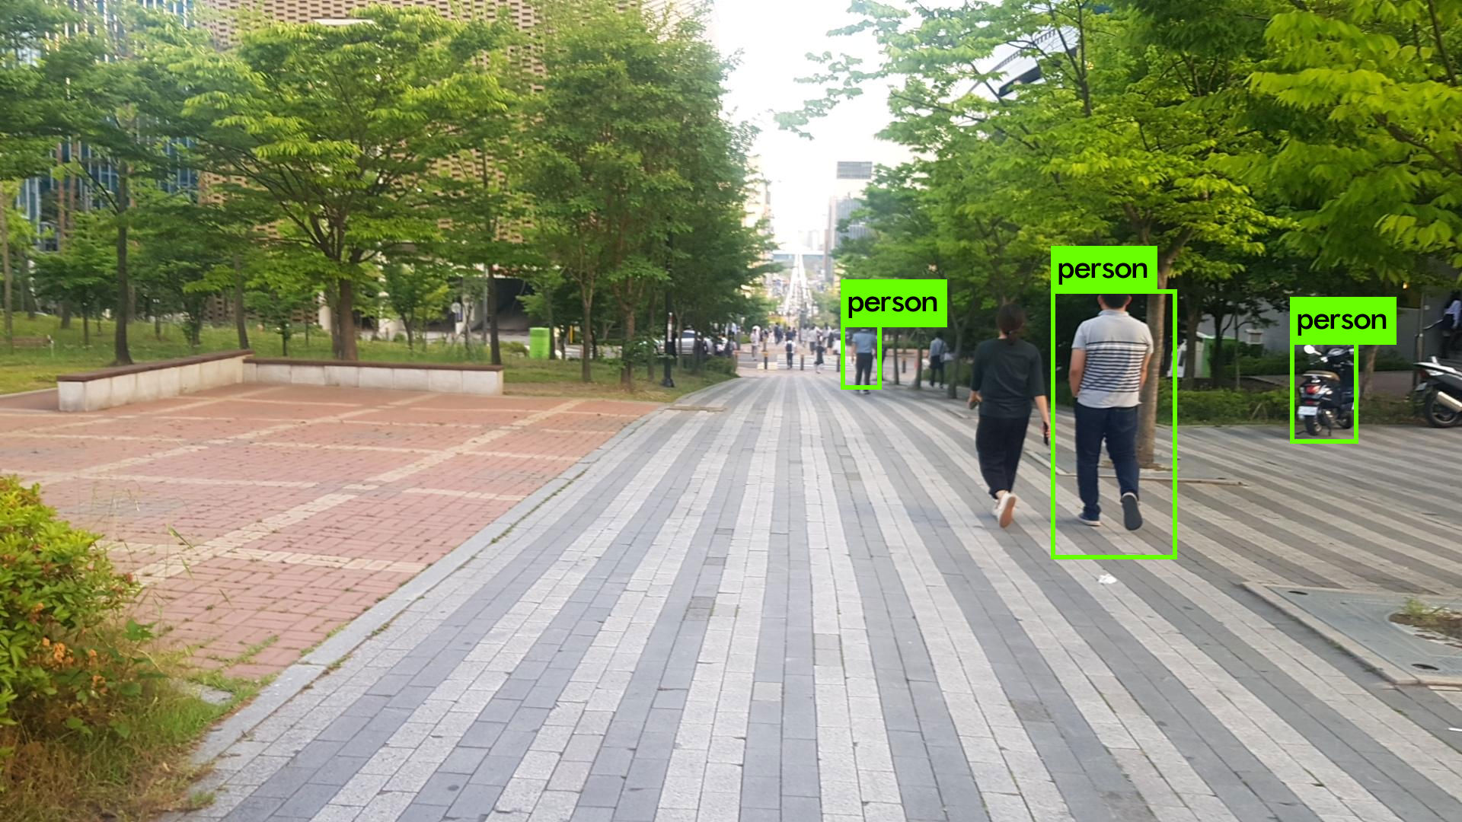
TESTWORKS
Result of training with NIA dataset

Slide 13
TESTWORKS
Thank You.

